Slide 1
Lecture 7: The Tree Data Structure
Keren Zhu
kerenzhu@cse.cuhk.edu.hk

Slide 2
Announcement
Midterm on Feb 26
Stack, queue, insertion sorting, list, linked list, array, dynamic array, trees, priority queue, heap, etc.
Quiz on Feb 19 or 20
HW2 due Jan 30
HW3 will be posted this week and due Feb 13
Covers basic trees, BST and RBT
PA1 will be posted this week and due Feb 20 (Tuesday after Chinese new year week)

Slide 3
Topics in this lectures
Trees: a wide-ranged family of data structures
We will discuss the important concepts and terminologies today
Root, internal, and leaf nodes
Parents, children, and siblings
Paths, path length, height, and depth
Ancestors and descendants
Ordered and unordered trees
Subtrees
We will also discuss tree traversal
BFS vs DFS
Using stacks or recursion

Slide 4
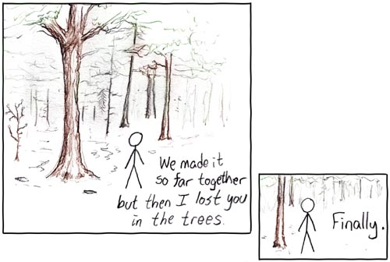
The Tree Data Structure
Trees are the first data structure different from what you’ve seen in your first-year programming courses
http://xkcd.com/71/

Slide 5
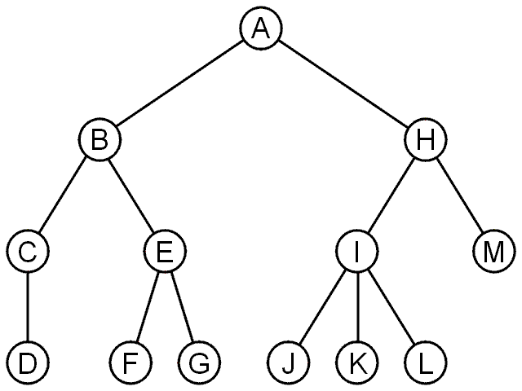
Trees
A rooted tree data structure stores information in nodes
Similar to linked lists:
There is a first node, or root
Each node has variable number of references to successors
Each node, other than the root, has exactly one node pointing to it

Slide 6
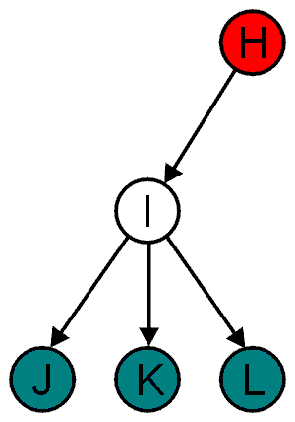
Terminology
All nodes will have zero or more child nodes or children
I has three children: J, K and L
For all nodes other than the root node, there is one parent node
H is the parent I

Slide 7
Terminology
The degree of a node is defined as the number of its children: deg(I) = 3
Nodes with the same parent are siblings
J, K, and L are siblings

Slide 8
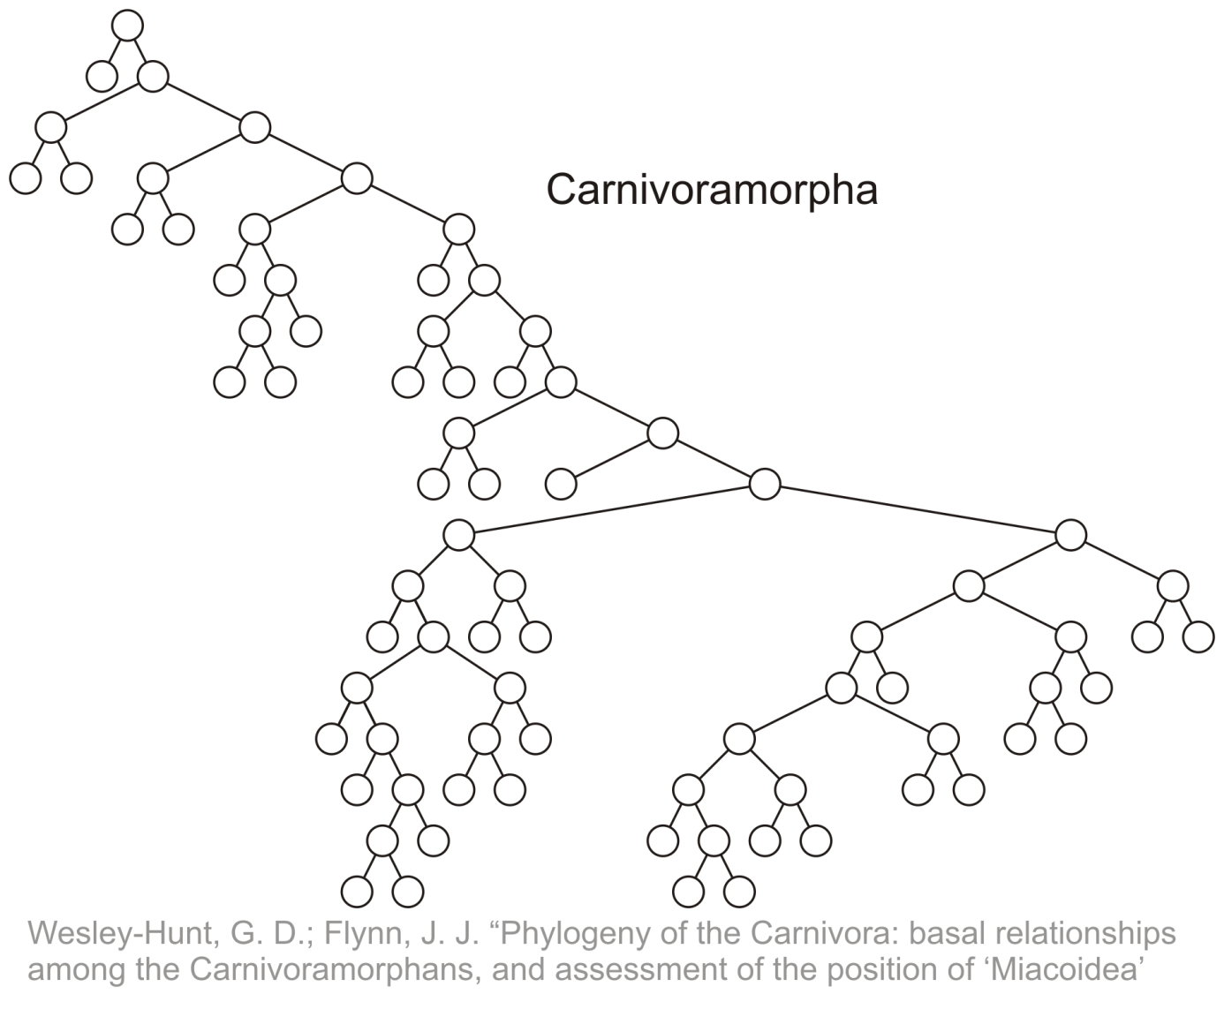
Terminology
Phylogenetic trees have nodes with degree 2 or 0:

Slide 9
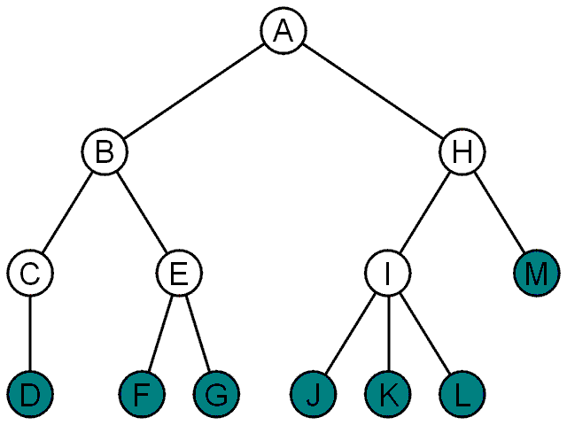
Terminology
Nodes with degree zero are also called leaf nodes
All other nodes are said to be internal nodes, that is, they are internal to the tree

Slide 10
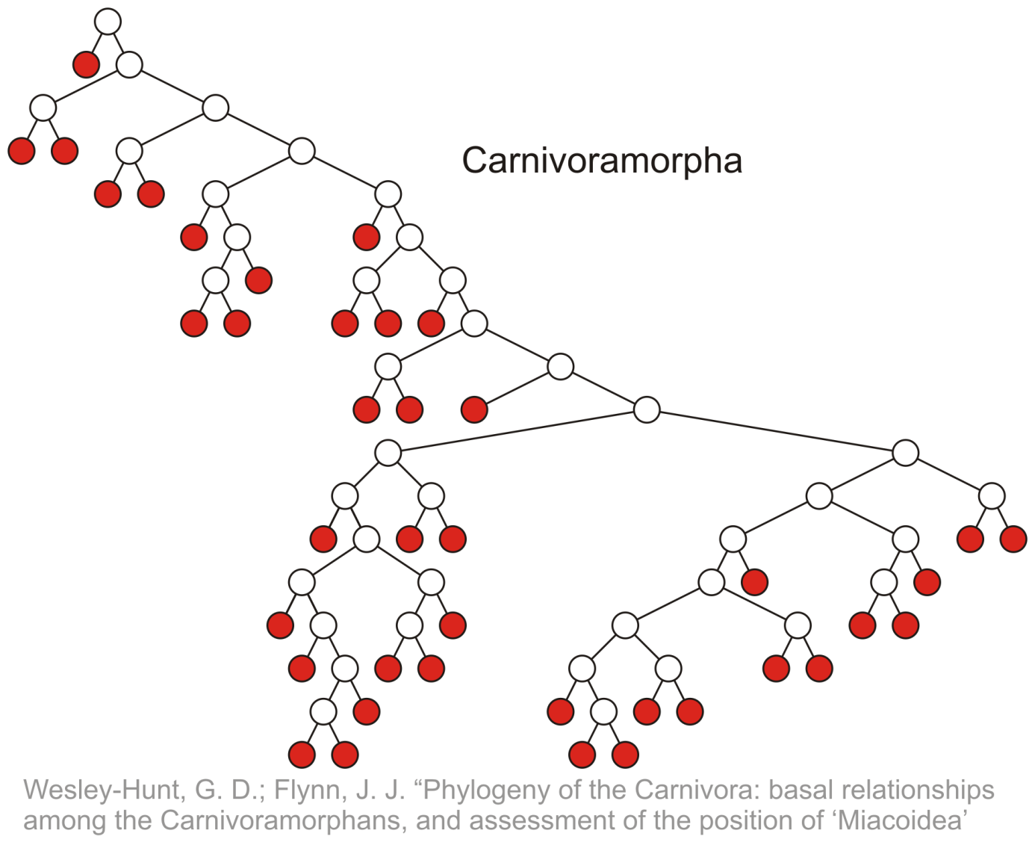
Terminology
Leaf nodes:

Slide 11
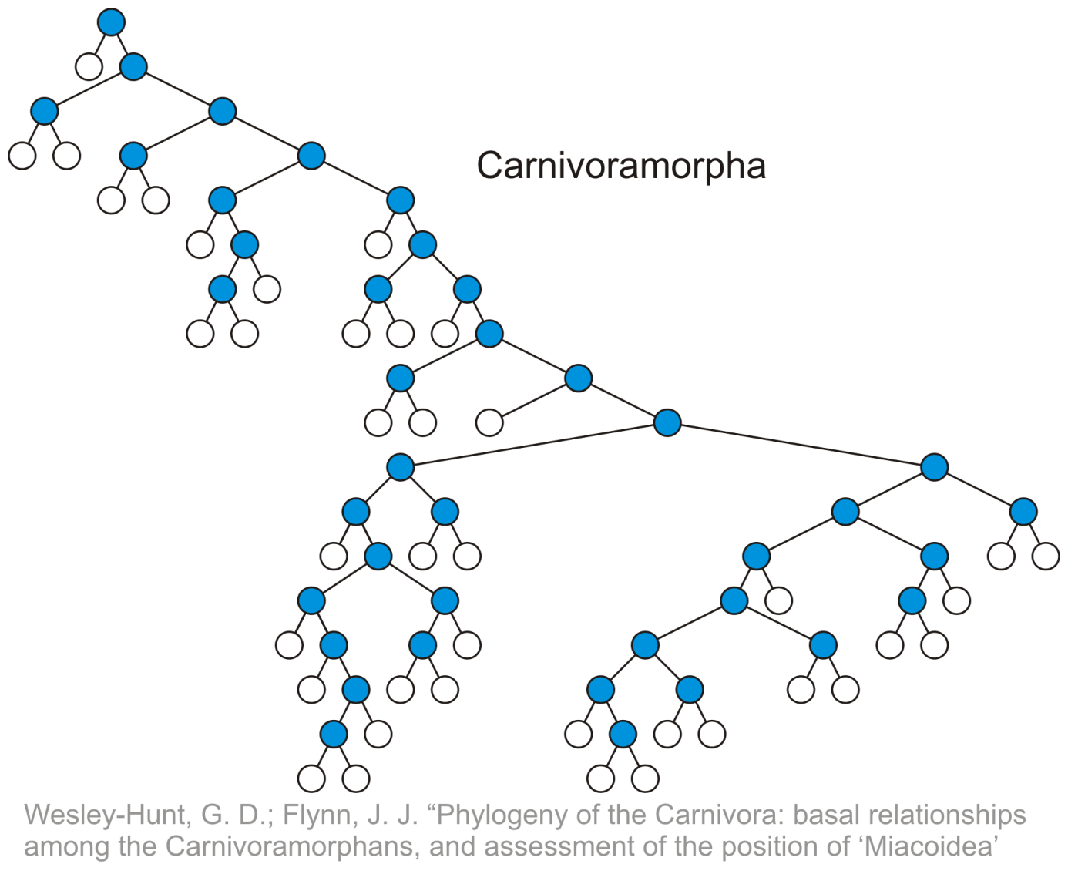
Terminology
Internal nodes:

Slide 12
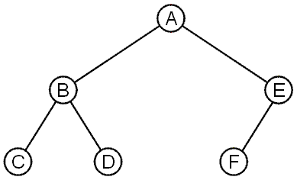
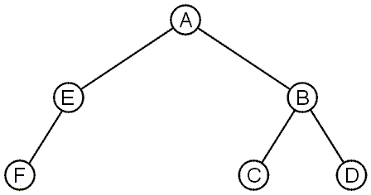
Terminology
These trees are equal if the order of the children is ignored
unordered trees
They are different if order is relevant (ordered trees)
We will usually examine ordered trees (linear orders)
In a hierarchical ordering, order is not relevant

Slide 13
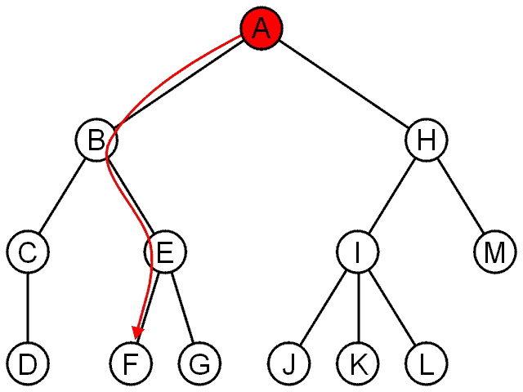
Terminology
The shape of a rooted tree gives a natural flow from the root node, or just root

Slide 14
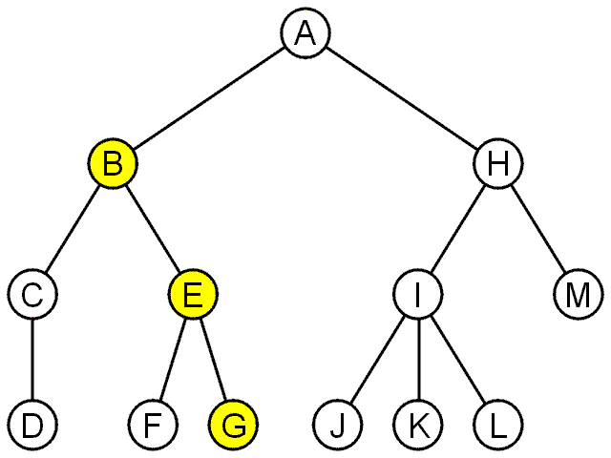
Terminology
A path is a sequence of nodes
(a₀, a₁, ..., a_{n})
where a_{k + 1} is a child of a_{k} is
The length of this path is n
E.g., the path (B, E, G) has length 2

Slide 15
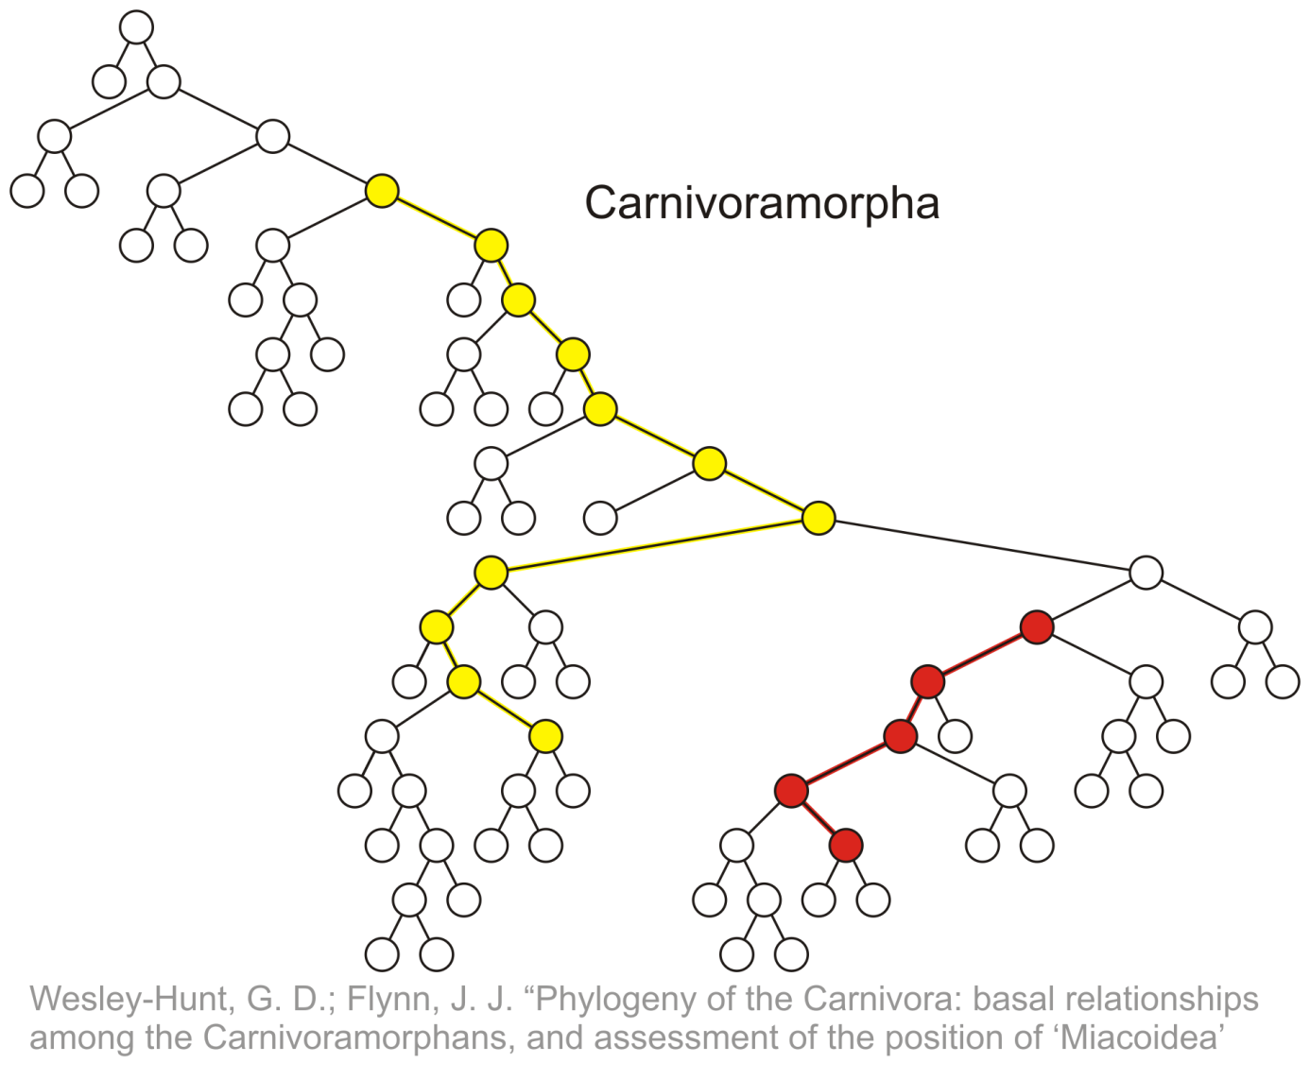
Terminology
Paths of length 10 (11 nodes) and 4 (5 nodes)
Start of these paths
End of these paths

Slide 16
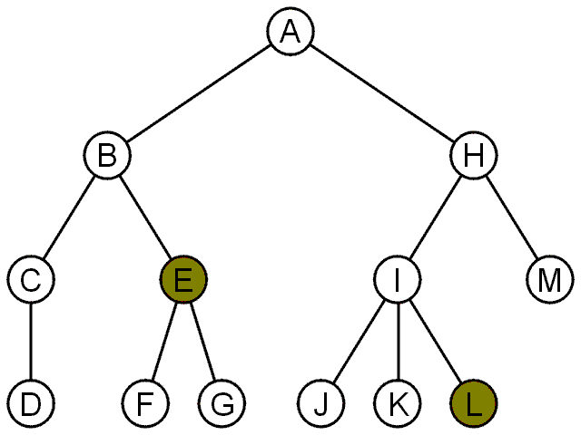
Terminology
For each node in a tree, there exists a unique path from the root node to that node
The length of this path is the depth of the node, e.g.,
E has depth 2
L has depth 3

Slide 17
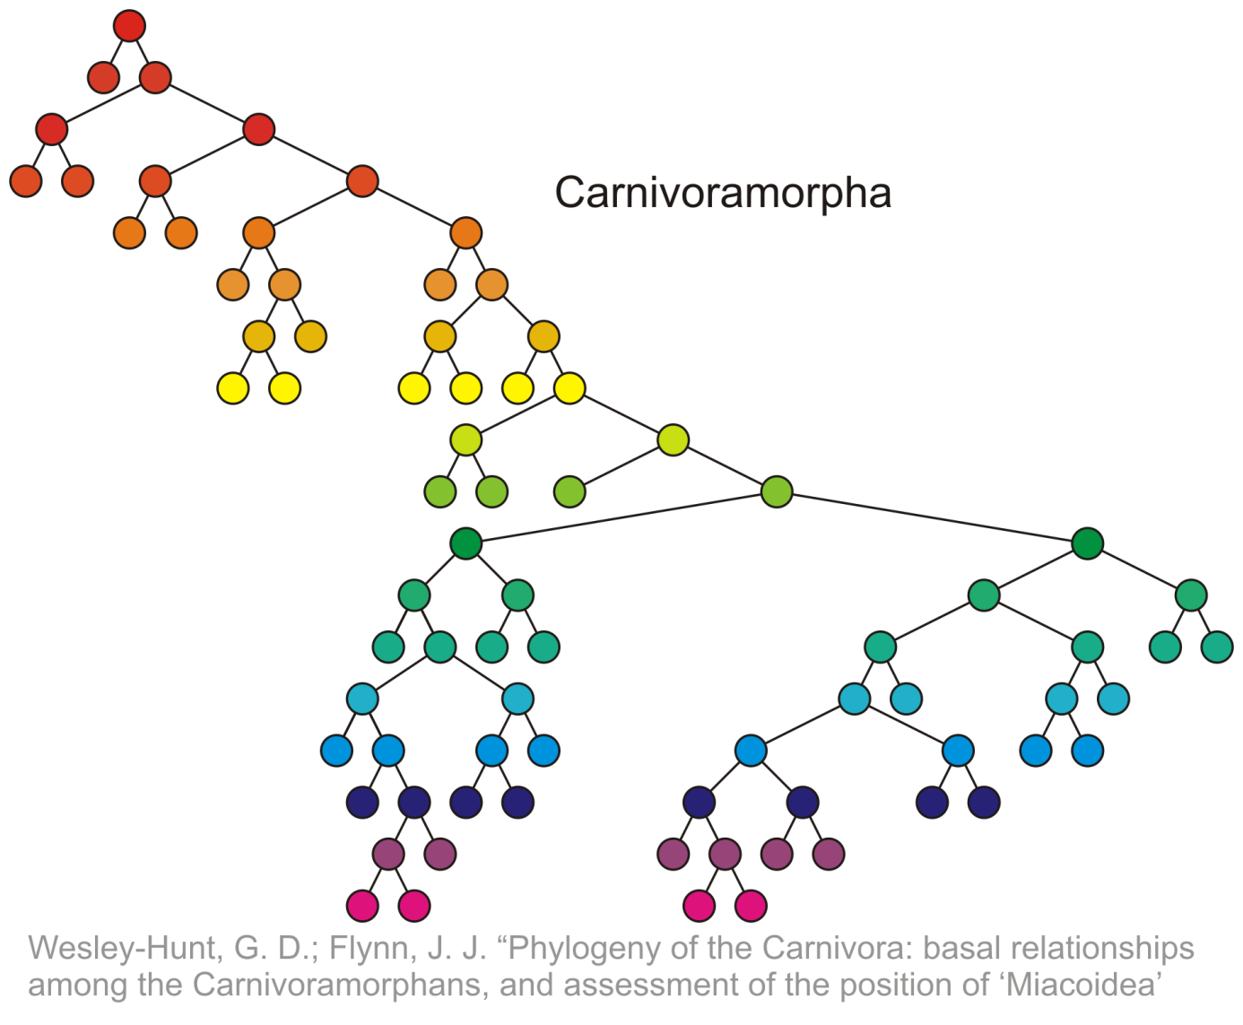
Terminology
Nodes of depth up to 17
0
4
9
14
17

Slide 18
Terminology
The height of a tree is defined as the maximum depth of any node within the tree
The height of a tree with one node is 0
Just the root node
For convenience, we define the height of the empty tree to be –1

Slide 19
Terminology
The height of this tree is 17
17

Slide 20
Terminology
If a path exists from node a to node b:
a is an ancestor of b
b is a descendent of a
Thus, a node is both an ancestor and a descendant of itself
We can add the adjective strict to exclude equality: a is a strict descendent of b if a is a descendant of b but a ≠ b
The root node is an ancestor of all nodes

Slide 21
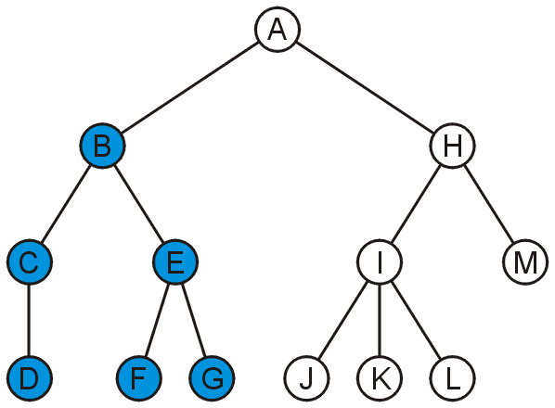
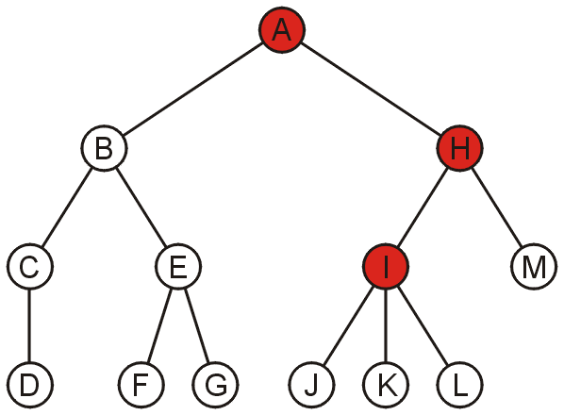
Terminology
The descendants of node B are B, C, D, E, F, and G:
The ancestors of node I are I, H, and A:

Slide 22
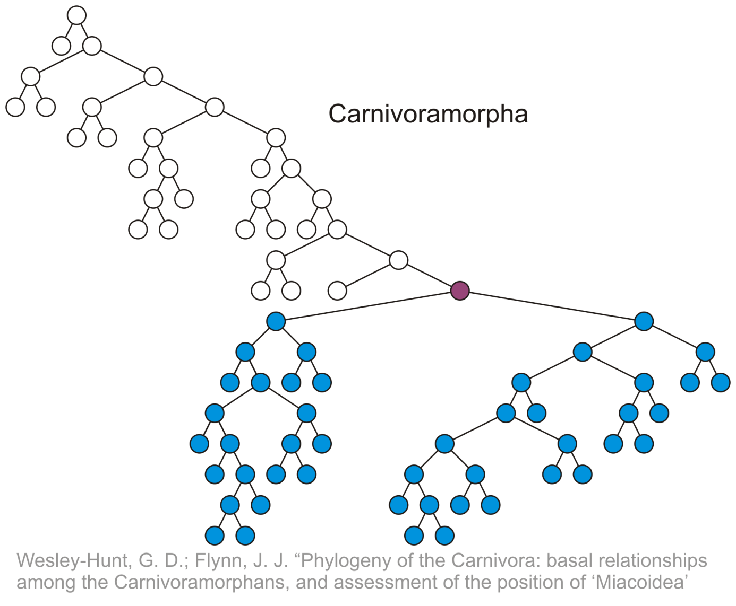
Terminology
All descendants (including itself) of the indicated node

Slide 23
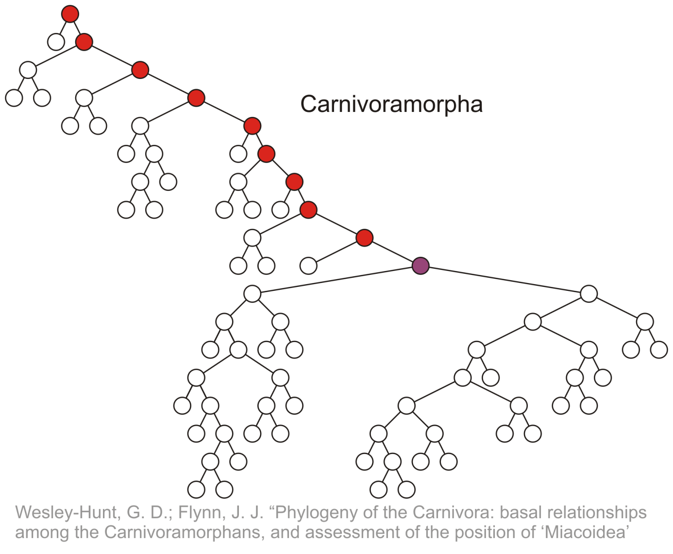
Terminology
All ancestors (including itself) of the indicated node

Slide 24
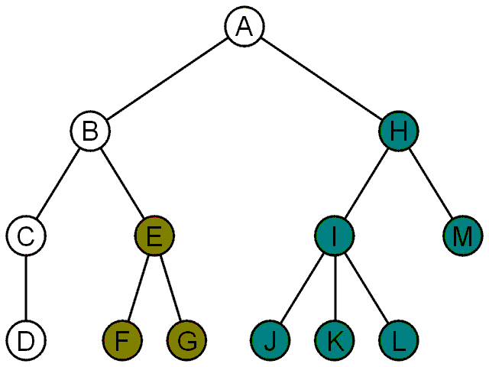
Terminology
Another approach to a tree is to define the tree recursively:
A degree-0 node is a tree
A node with degree n is a tree if it has n children and all of its children are disjoint trees (i.e., with no intersecting nodes)
Given any node a within a tree with root r, the collection of a and all of its descendants is said to be a subtree of the tree with root a

Slide 25
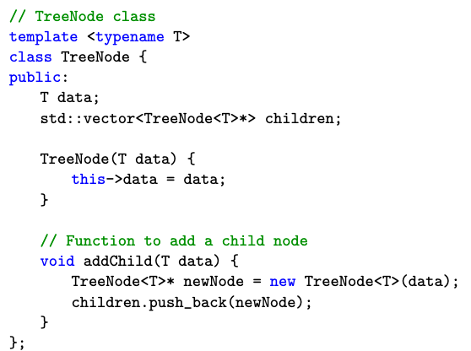
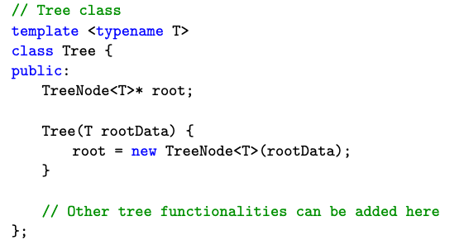
A C++ implementation of tree
Trees can be implemented in different approach
Below shows an example of using pointer to implement a general tree
There are many different ways (like vector of nodes)

Slide 26
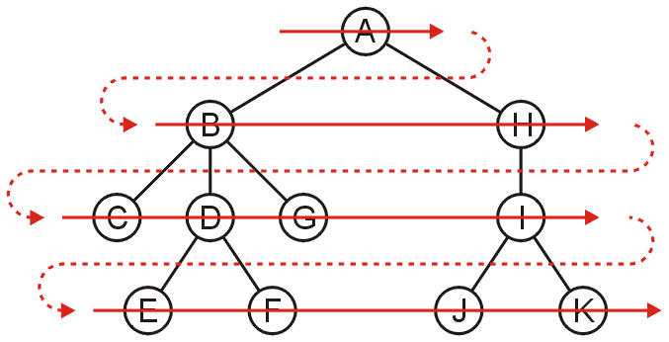
Breadth-First Traversal
Breadth-first traversals visit all nodes at a given depth
Can be implemented using a queue
Run time is Θ(n)
Memory is potentially expensive: maximum nodes at a given depth
Order: A B H C D G I E F J K

Slide 27
Breadth-First Traversal
The implementation was already discussed:
Create a queue and push the root node onto the queue
While the queue is not empty:
Push all of its children of the front node onto the queue
Pop the front node

Slide 28
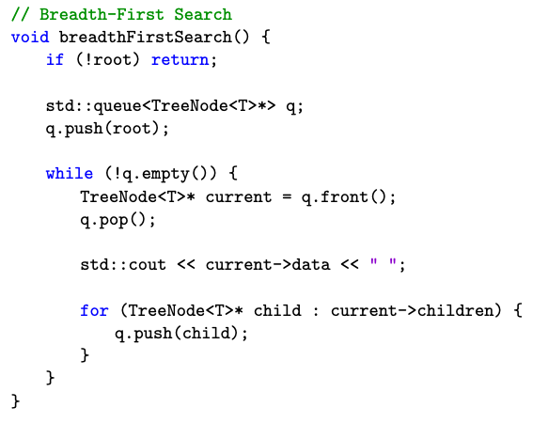
C++ for BFS using queue

Slide 29
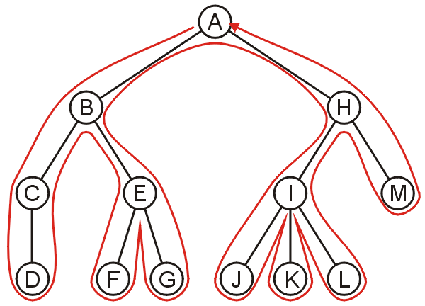
Backtracking
To discuss depth-first traversals, we will define a backtracking algorithm for stepping through a tree:
At any node, we proceed to the first child that has not yet been visited
Or, if we have visited all the children (of which a leaf node is a special case), we backtrack to the parent and repeat this decision making process
We end once all the children of the root are visited

Slide 30
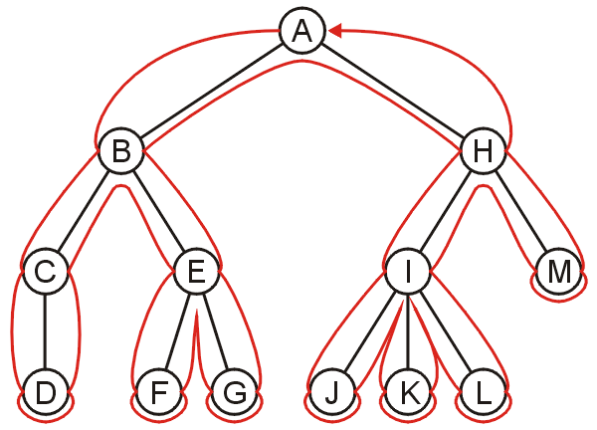
Depth-first Traversal
We define such a path as a depth-first traversal
We note that each node could be visited twice in such a scheme
The first time the node is approached (before any children)
The last time it is approached (after all children)

Slide 31
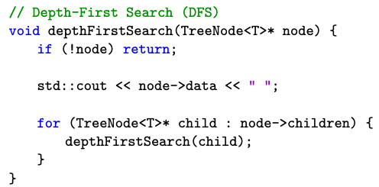
Implementing depth-first traversals
Depth-first traversals can be implemented with recursion:

Slide 32
Implementing depth-first traversals
Performed on this tree, the output would be
<A><B><C><D></D></C><E><F></F><G></G></E></B><H><I><J></J><K></K><L></L></I><M></M></H></A>

Slide 33
Implementing depth-first traversals
Alternatively, we can use a stack:
Create a stack and push the root node onto the stack
While the stack is not empty:
Pop the top node
Push all of the children of that node to the top of the stack in reverse order
Run time is Θ(n)
The objects on the stack are all unvisited siblings from the root to the current node
If each node has a maximum of two children, the memory required is Θ(h): the height of the tree
With the recursive implementation, the memory is Θ(h): recursion just hides the memory
Notes:
33

Slide 34
Applications
Tree application: displaying information about directory structures and the files contained within
Finding the height of a tree
Printing a hierarchical structure
Determining memory usage

Slide 35
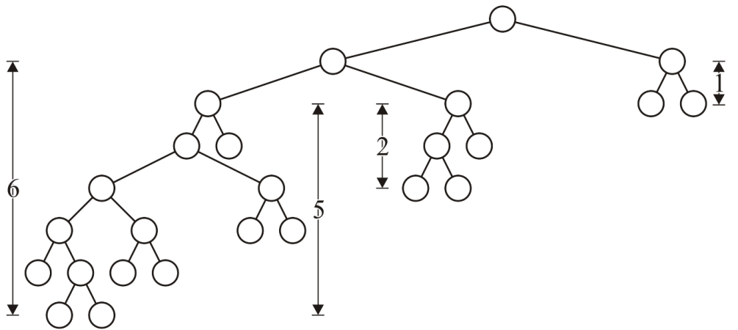
Height
The int height() const function is recursive in nature:
Before the children are traversed, we assume that the node has no children and we set the height to zero: h_{current} = 0
In recursively traversing the children, each child returns its height h and we update the height if 1 + h > h_{current}
Once all children have been traversed, we return h_{current}
When the root returns a value, that is the height of the tree

Slide 36
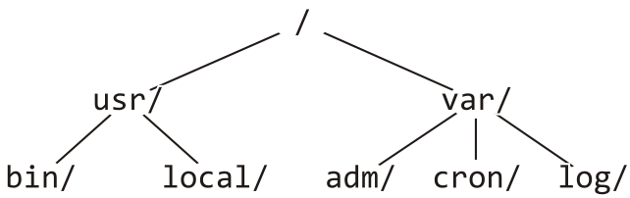
Printing a Hierarchy
Consider the directory structure presented on the left—how do we display this in the format on the right?
/
usr/
bin/
local/
var/
adm/
cron/
log/
What do we do at each step?

Slide 37
Printing a Hierarchy
For a directory, we initialize a tab level at the root to 0
We then do:
Before the children are traversed, we must:
Indent an appropriate number of tabs, and
Print the name of the directory followed by a '/'
In recursively traversing the children:
A value of one plus the current tab level must be passed to the children, and
No information must be passed back
Once all children have been traversed, we are finished

